Slide 1
Mathematical Morphology Operation
By Ramakant Ganjeshwar

Slide 2
Mathematical Morphology
The term “Morphology” generally represent the branch of Biology that deals with the form and structure of Animals and plants.
However, we use the same term in mathematical morphology to extract image component useful in region shape, boundaries etc.
Mathematical Morphology is a tool for extracting image components that are useful for representation and description.
This technique was originally developed by Matheron and Serra at the Ecole des Mines in Paris.

Slide 3
Mathematical Morphology
Morphology is one of several tools developed in the remainder of the book such as segmentation, feature extraction, and object recognition that form the foundation of techniques for extracting “meaning” from an image.

Slide 4
Morphological Operations
Morphological Operations defined in the term of Sets.
In image processing we use morphology with two types of set of pixels.
Objects : set of Foreground pixels
Structuring elements : Specified in term of both Background and Foreground.

Slide 5
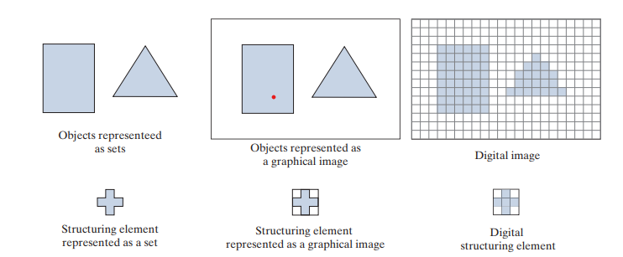
Morphological Operations

Slide 6
Morphological Operations
Dilation: Dilation adds pixels on the object boundaries.
Erosion: Erosion removes pixels on object boundaries.
Open: The opening operation erodes an image and then dilates the eroded image, using the same structuring element for both operations.
Close: The closing operation dilates an image and then erodes the dilated image, using the same structuring element for both operations.

